Slide 1
Machine Learning
Jie Tang
Department of Computer Science & Technology
Tsinghua University

Slide 2
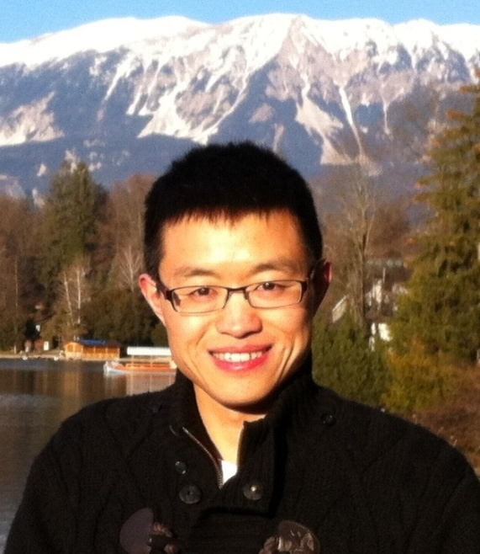
A bit about Jie…
Jie Tang, Tenured associate professor, Department of Computer Science of Tsinghua Univ. My research interests include social networks, data mining, and machine learning.
I have been visiting scholar at Cornell U. (working with John Hopcroft, Jon Kleinberg), UIUC (working with Jiawei Han), CUHK (with Jeffrey Yu), and HKUST (with Qiong Luo).
I was awarded with the CCF Young Scientist Award, NSFC Excellent Young Scholar, Newton Advanced Fellowships Award, IBM Innovation Faculty Award, and New Star of Beijing S&T.
Have published more than 200 paper on major international conf/journals, including KDD (18), IJCAI/AAAI (13), IEEE TKDE (8), ICML, Machine Learning
#Citation: 6,890 and H-index: 41
Have a notable system, AMiner.org for academic researcher network analysis. The system has attracted 8.32 million users from 220 countries/regions.
Homepage: http://keg.cs.tsinghua.edu.cn/jietang/

Slide 3
Contact Information
Jie Tang
Software Division, Department of Computer Science, Tsinghua U.
Office: Rm 1-308, FIT Building
E-mail: jietang@tsinghua.edu.cn
Phone: 62788788-20, 13911215746

Slide 4
Teaching Assistant
TA: Fang Zhang
FIT 1-308
E-mail: thuzhf@gmail.com
Phone: 62788788-20
Open hours: 15:00pm-18:00pm Tuesday

Slide 5
Resources
Conferences:
Theory: NIPS, COLT, STOC/FOCS
Algorithm: ICML, KDD, UAI, IJCAI/AAAI
App: SIGIR, WWW, ACL
Journals:
JMLR, JAIR, MLJ, ACM TKDD, IEEE TKDE

Slide 6
Why Machine Learning?
Jie Tang
Department of Computer Science & Technology
Tsinghua University

Slide 7
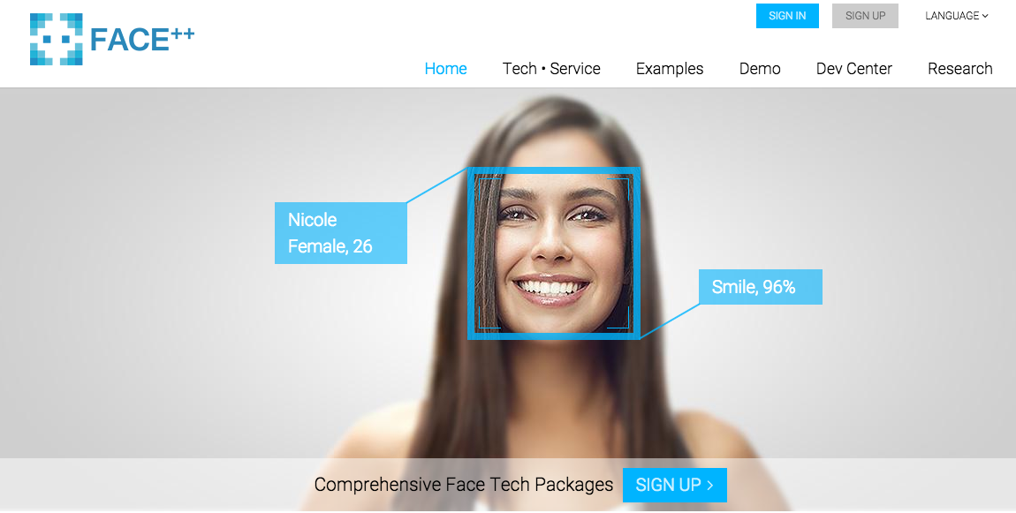
Face Recognition

Slide 8
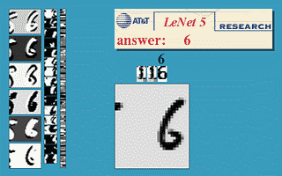
Handwritten Recognition
Convolutional neural networks for handwritten recognition
http://yann.lecun.com/exdb/lenet/index.html

Slide 9

Follow back Prediction
When you follow a friend in Twitter, how likely he will follow back?

Slide 10
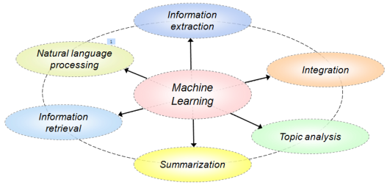
IE from Web Page (IJCAI’07)
October 14, 2002, 4:00 a.m. PT
For years, Microsoft Corporation CEO Bill Gates railed against the economic philosophy of open-source software with Orwellian fervor, denouncing its communal licensing as a "cancer" that stifled technological innovation.
Today, Microsoft claims to "love" the open-source concept, by which software code is made public to encourage improvement and development by outside programmers. Gates himself says Microsoft will gladly disclose its crown jewels--the coveted code behind the Windows operating system--to select customers.
"We can be open source. We love the concept of shared source," said Bill Veghte, a Microsoft VP. "That's a super-important shift for us in terms of code access.“
Richard Stallman, founder of the Free Software Foundation, countered saying…
*
Microsoft Corporation
CEO
Bill Gates
Microsoft
Gates
Microsoft
Bill Veghte
Microsoft
VP
Richard Stallman
founder
Free Software Foundation
*
*
NAME
TITLE ORGANIZATION
Bill Gates
CEO
Microsoft
*
Bill
Veghte
VP
Microsoft
Richard
Stallman
founder
Free Soft..

Slide 11
Sentiment Summary (WWW’08)
Topic-sentiment summary
Topic-sentiment dynamics (Topic = Price)
Query: Dell Laptop
strength
Positive
positive
negative
neutral
Negative
it is the best site and they show Dell coupon code as early as possible
Even though Dell's price is cheaper, we still don't want it.
mac pro vs. dell precision: a price comparis..
Neutral
Topic 1
(Price)
DELL is trading at $24.66
……
One thing I really like about this Dell battery is the Express Charge feature.
my Dell battery sucks
i still want a free battery from dell..
Topic 2
(Battery)
Stupid Dell laptop battery
……
……
time
Unsupervised/Semi-supervised discovery of topics and
different sentiments of the topics

Slide 12
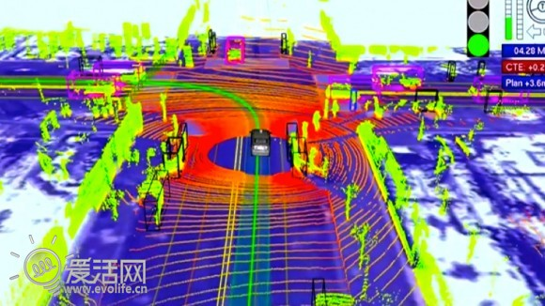
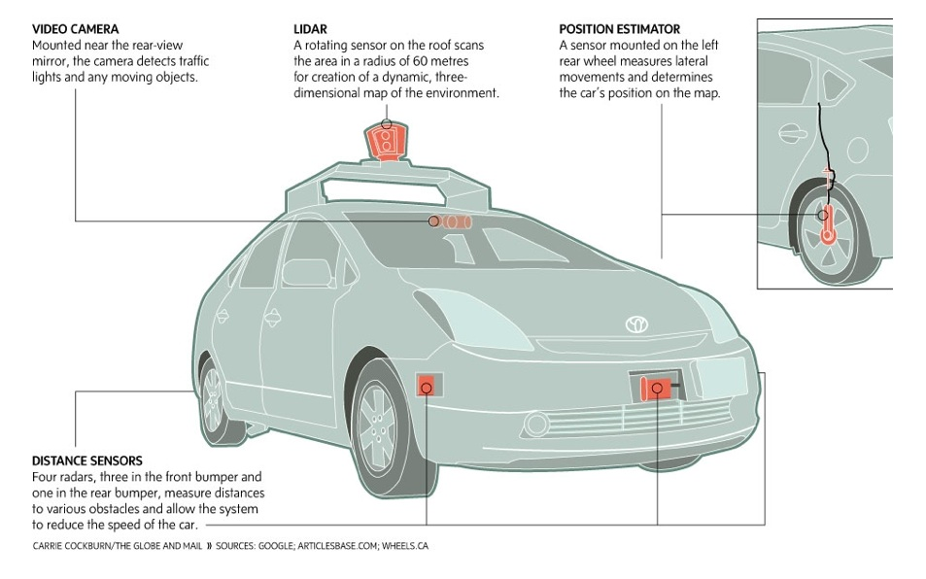
BIG DATA—Google driverless car
The system combines information gathered from Google Street View with artificial intelligence software that combines input from video cameras inside the car, a LIDAR sensor on top of the vehicle, radar sensors on the front of the vehicle and a position sensor attached to one of the rear wheels that helps locate the car's position on the map
Google's self-driving cars last month hit a 480,000-miles-driven milestone.
--2012/09
Self-driving cars to create 1GB of data per second
http://www.fiercebigdata.com/story/self-driving-cars-create-1gb-data-second/2013-07-22
Notes:
which, the company says, haven't resulted in a single accident that wasn't the result of human error.

Slide 13

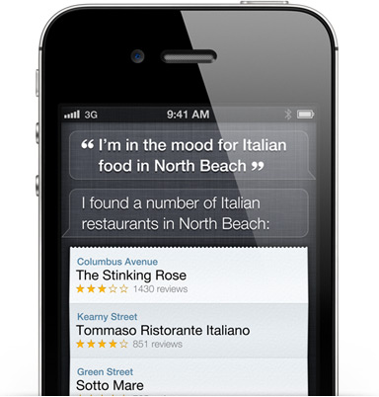
IPhone Siri
Siri understands what you say, knows what you mean, and even talks back.
Siri (pronounced /ˈsɪri/) is an intelligent personal assistant and knowledge navigator which works as an application for Apple's iOS. The application uses a natural language user interface to answer questions, make recommendations, and perform actions by delegating requests to a set of Web services. Apple claims that the software adapts to the user's individual preferences over time and personalizes results, and performing tasks such as finding recommendations for nearby restaurants, or getting directions

Slide 14
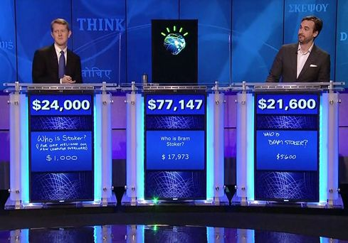
IBM Watson
Watson is a Question answering (QA) computing system built by IBM. IBM describes it as "an application of advanced Natural Language Processing, Information Retrieval, Knowledge Representation and Reasoning, and Machine Learning technologies to the field of open domain question answering" which is "built on IBM's DeepQA technology for hypothesis generation, massive evidence gathering, analysis, and scoring
In 2011, as a test of its abilities, Watson competed on the quiz show Jeopardy!, in the show's only human-versus-machine match-up to date
Watson had access to 200 million pages of structured and unstructured content consuming four terabytes of disk storage including the full text of Wikipedia, but was not connected to the Internet during the game. For each clue, Watson's three most probable responses were displayed on the television screen. Watson consistently outperformed its human opponents on the game's signaling device.

Slide 15
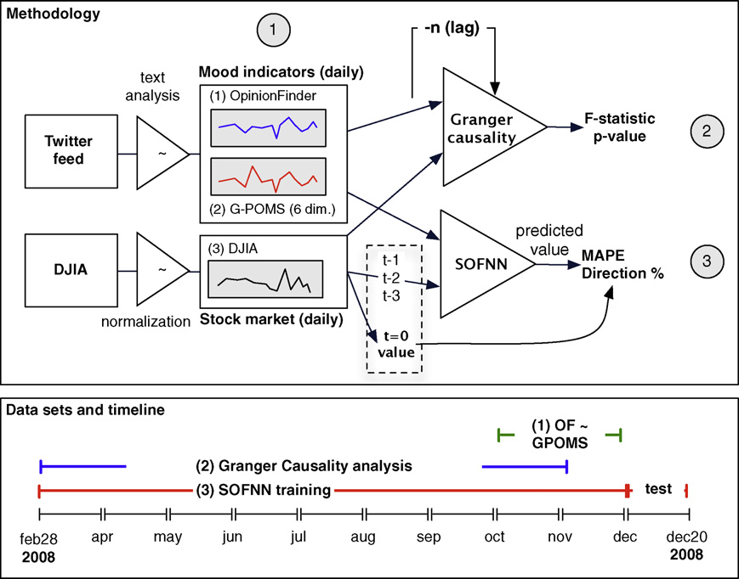
Stock Prediction using Twitter Mood
The paper investigates whether public sentiment, as expressed in large-scale collections of daily Twitter posts, can indeed be used to predict the stock market.
Two tools are used to measure variations in the public mood from Twitter’s tweets from February 28, 2008 to December 19, 2008. The resulting public mood time series are correlated to the Dow Jones Industrial Average (DJIA) to assess their ability to predict changes in the DJIA over time.
The results indicate that the prediction ccuracy of standard stock market prediction models is significantly improved when certain mood dimensions are included.
Bollen, J., Mao, H., Zeng, X.: Twitter mood predicts the stock market. Journal of Computational Science, Volume 2, Issue 1, March 2011, Pages 1–8

Slide 16
What is Machine Learning?

Slide 17
Data Structures
An example with p features
x_{i}=[x_{i1}, x_{i2},…, x_{ip}]
Data (set) matrix

Slide 18

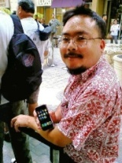
Example: Follow-back Prediction
When a follow b, we have a new instance x_{i};
If b immediately follow back a, we say y_{i}=1;
otherwise y_{i}=0;
x_{i}={#fans of a, #fans of b, #common friends between a and b}
?
You
Lady Gaga
If you follow Lady Gaga on Twitter, will she follow back?
Classification

Slide 19
Supervised Learning
Training example
Training set
* x_{i} is a vector and x_{ik} represents the k-th feature of example x_{i}

Slide 20
Supervised Learning
Given a training set S={(x₁, y₁),(x₂, y₂),…,(x_{N}, y_{N})}, and x_{i}∈X=R^{m}, i=1,2,…,N
To learn a function f(x), which can best fit the data
x_{new}
Training data {(x_{i},y_{i})}
Learning algorithm
f
Predicted y
Regression: When y is continuous (i.e., y_{i}∈Y=R), we call the learning problem as regression.
Classification: When y can take on only a small number of discrete values (e.g., the binary case y_{i}∈Y={1,-1}), we call the learning problem as classification.

Slide 21
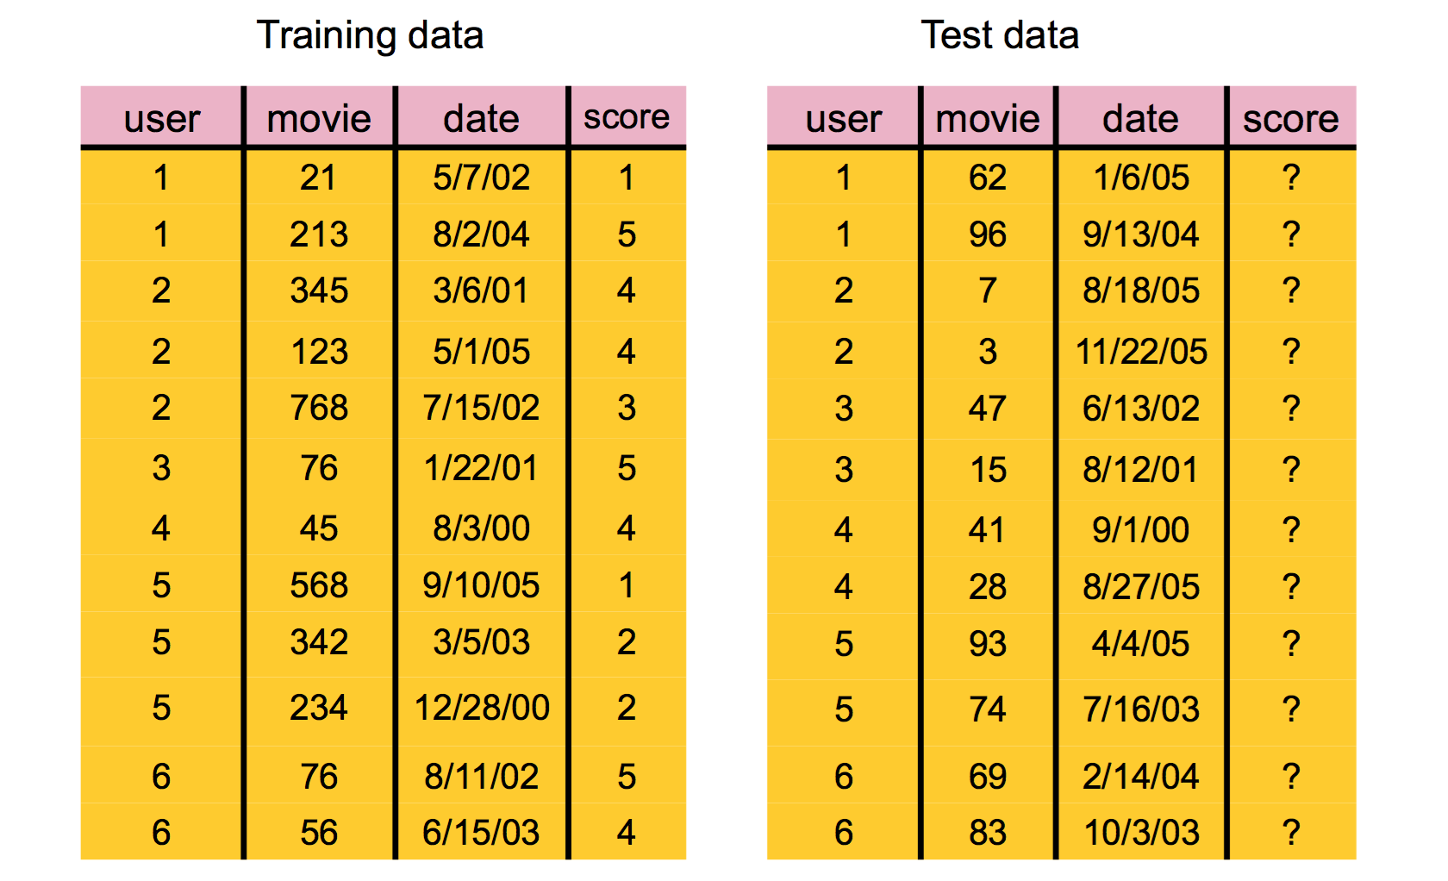
Netflix Prize
Notes:
The competition began on October 2, 2006. By October 8, a team called WXYZConsulting had already beaten Cinematch's results
On 21 September 2009, the grand prize of US$1,000,000 was given to the BellKor's Pragmatic Chaos team which bested Netflix's own algorithm for predicting ratings by 10.06%.^{[2]}

Slide 22
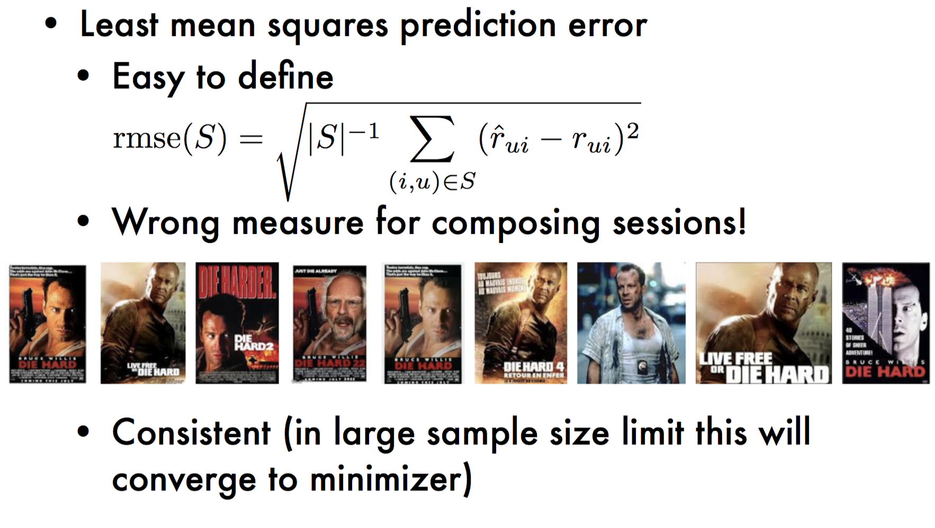
Rating Prediction

Slide 23
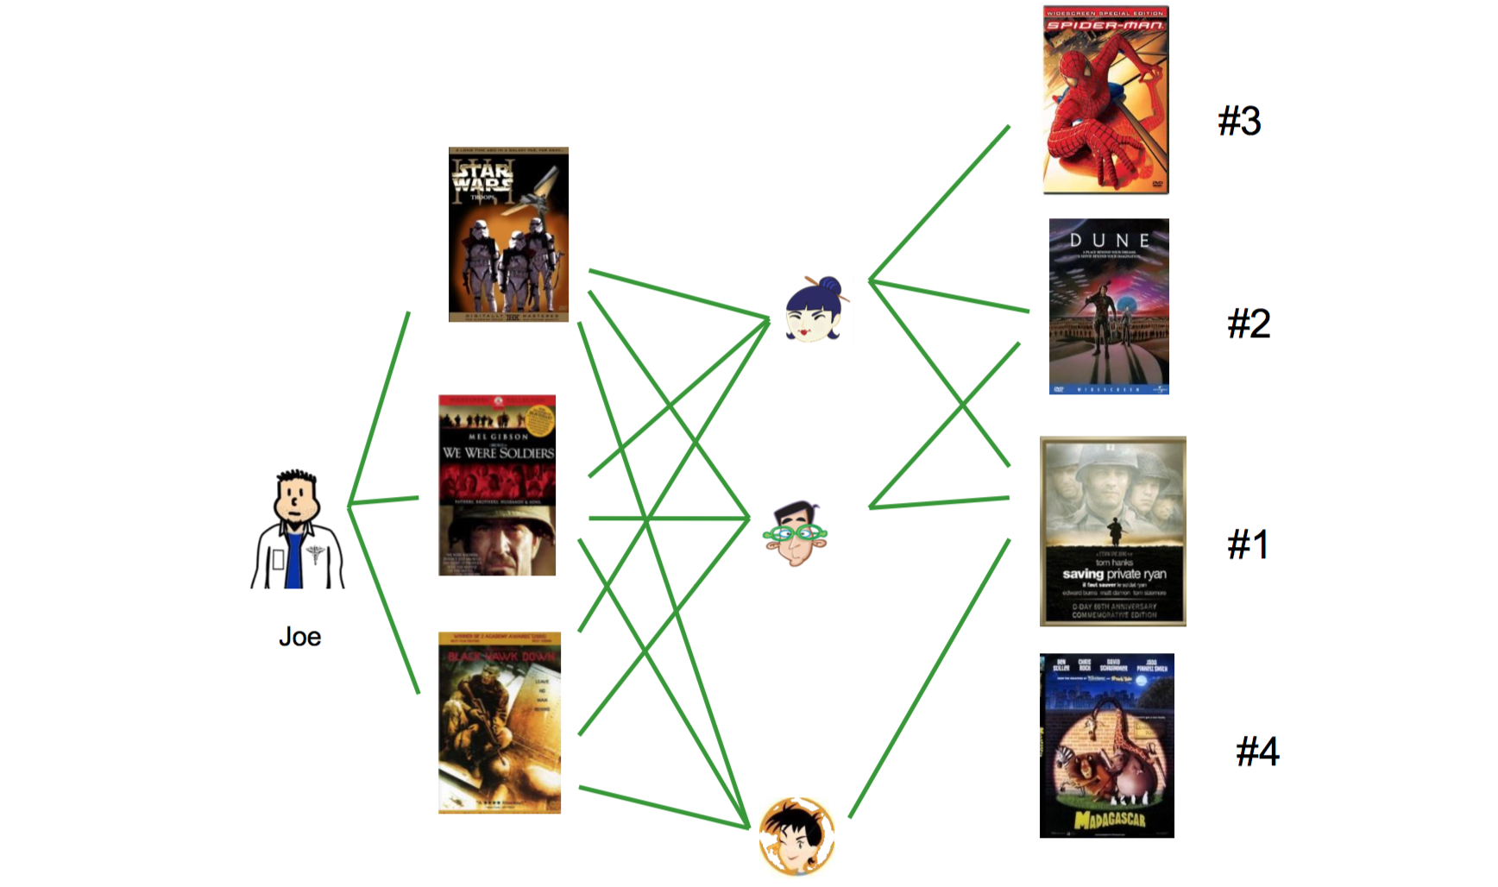
Basic Idea

Slide 24
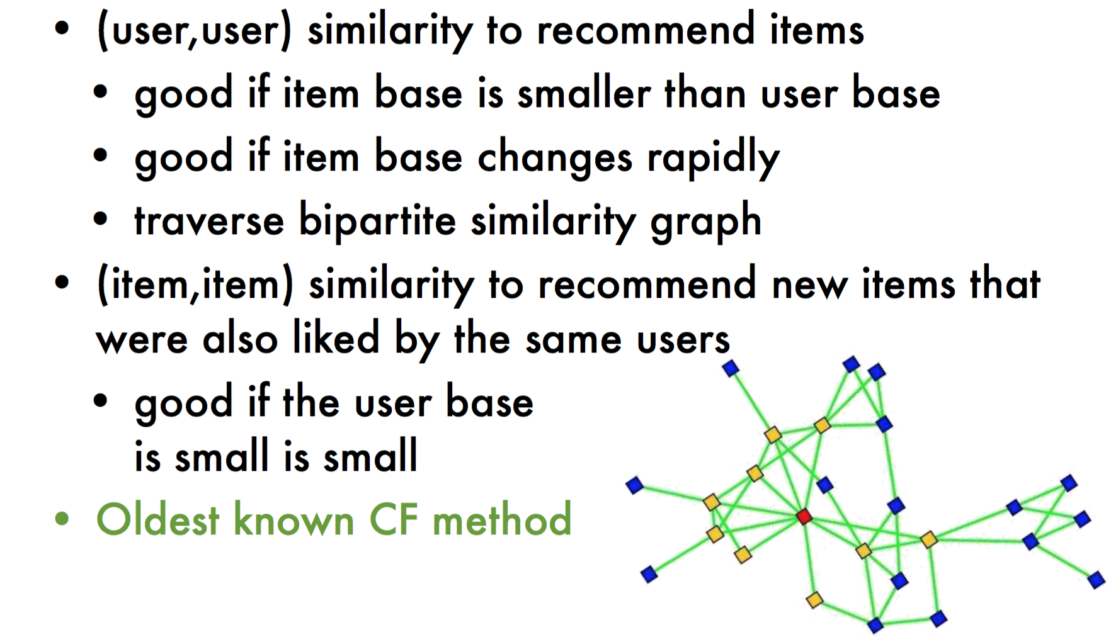
Basic Idea

Slide 25
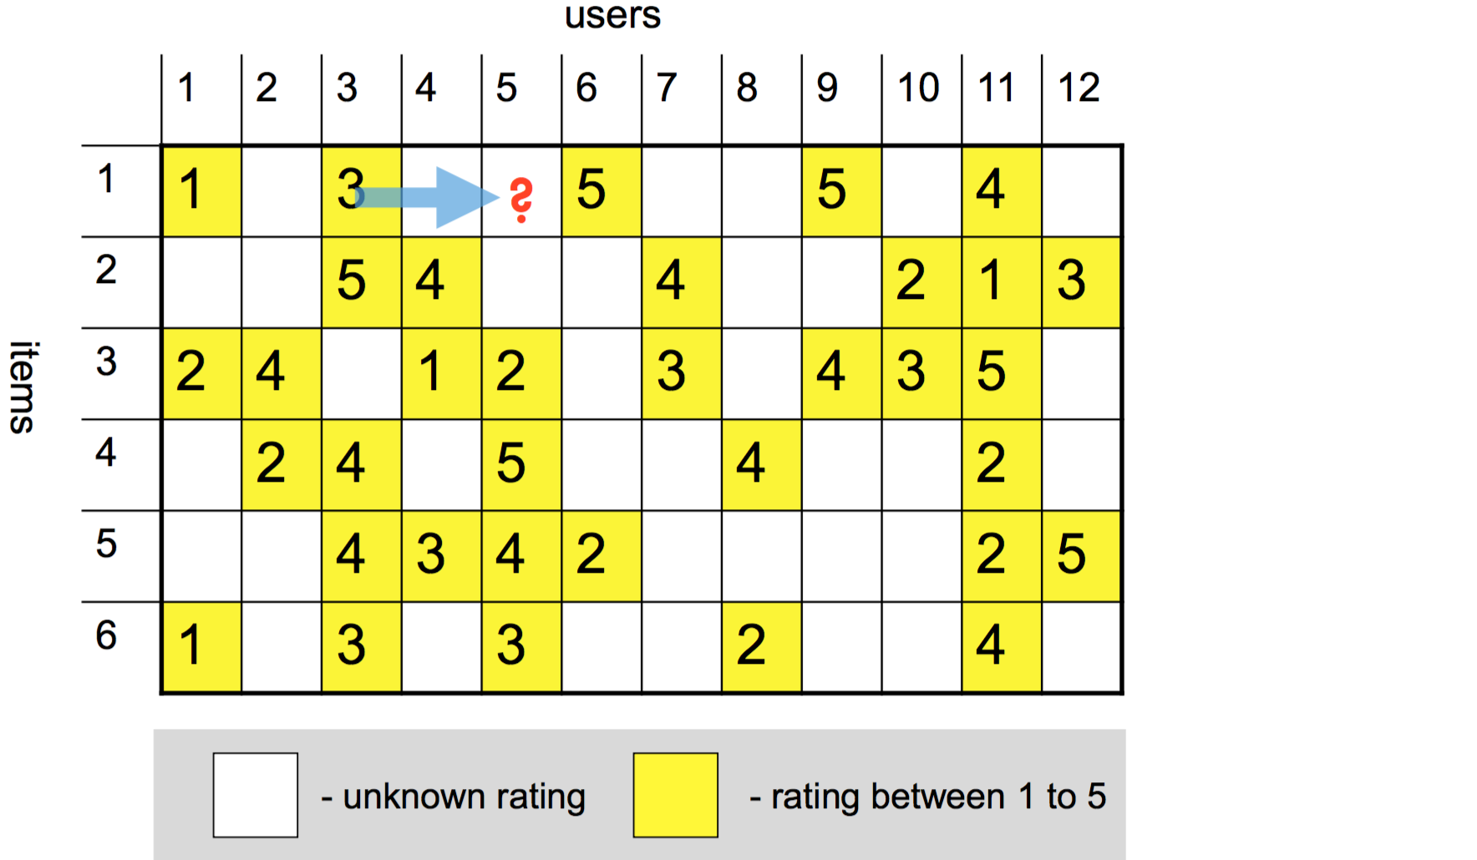
Intuitions

Slide 26


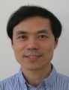
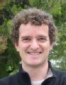

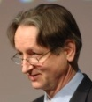
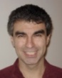






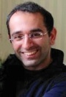
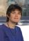
The State of Machine Learning
Classification models
Maximal Margin
Maximal margin sequential learning
Decision tree
Bayesian classifier
Perceptron
Neural networks
SVM
(Vapnik)
M3N network
(Ben Taskar)
Topic models
Deep learning
PLSI, LDA, etc.
Deep belief networks
Sequential learning
Sequential learning
Graphical models
HMM
MEMM, CRF,
voted perceptron
Factor graph,
Exponential model
For more from http://aminer.org/
Notes:
John Ross Quinlan (Sydney U.->RuleQuest)
Svm: John Shawe-Taylor
Deep learning: Geoffrey Hinton (DNN), Yoshua Bengio (DNN), Andrew Ng, Yann LeCun (CNN)
TM: thomas hofmann, Padhraic Smyth,
HMM: math (Leonard Esau Baum),
GM: Brendan J. Frey, Zoubin Ghahramani (Iran, in Cambridge), daphne koller, Michael Jordan

Slide 27
Prerequisites
Programming and other basic CS skills
C, C++
Java, C#, .NET
Perl, Python
Theories
Data representation (e.g., vector space model, language model)
Basic probability theory (e.g., likelihood, conditional probability, posterior probability, Bayes)
Basic linear algebra (e.g., linear transformations, eigenvalues, least-squares best fit)

Slide 28
Potential achievements
Able to understand the underlying principles of classical ML algorithms
Able to apply right ML algorithms to the applications at you hand
Able to design effective ML algorithms to solve new problems

Slide 29
Handbooks
Handbooks:
Christopher M. Bishop. Pattern Recognition and Machine Learning, Springer, 2007.
Yoshua Bengio, Ian J. Goodfellow, and Aaron Courville. Deep Learning. 2015.
Daphne Koller and Nir Friedman. Probabilistic Graphical Models. MIT Press, 2009
Additional references
John Hopcroft. Computer Science Theory for the Information Age. 2011.
Michael I. Jordan. An Introduction to Probabilistic Graphical Models. University of California, Berkeley. June 30, 2003.
Martin J. Wainwright and Michael I. Jordan. Graphical Models, Exponential Families, and Variational Inference, Foundations and Trends in Machine Learning, V1 (1-2), 2008.
Trevor Hastie, Robert Tibshirani, Jerome Friedman. Elements of Statistical Learning. Springer, 2003.
Yoshua Bengio. Learning Deep Architectures for AI. Foundations and Trends in Machine Learning, V2 (1), 2009.
David J.C. MacKay. Information Theory, Inference, and Learning Algorithms. Cambridge University Press, 2003.

Slide 30
Thanks!
HP: http://keg.cs.tsinghua.edu.cn/jietang/

